Slide 1



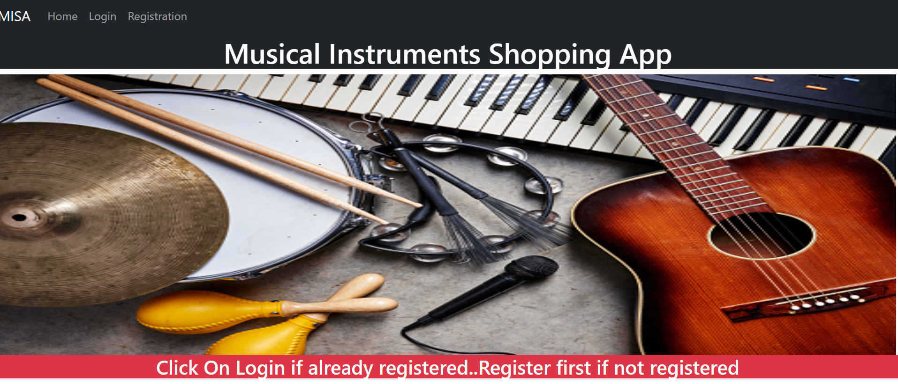
Center name:
Musical Instruments Shopping App
Presented by
PRN Name
220943020022 Devendra Patel
220943020031 Girijesh Gupta
220943020047 Aditya Kulkarni
220943020051 Sanket Maske
Guided by
Prof.Bakul Joshi

Slide 2
Content:
Introduction Architectural Design Technology and Software Logistics Related people Features of User Features of Seller Features of Admin Screenshots of system flow Conclusion and scope

Slide 3
Project Idea:
We have a personal interest in music and musical instrument
so we thought about creating an app that would make it easier
for people to shop for musical instruments online.

Slide 4
Introduction:
The Online musical shopping application is intended to provide complete solution for
Vendors
It will enable vendors to setup online shops
Customers
To browse through shop and purchase them online without having visit shop physically.
The Administrator to approve and reject requests for new sellers and maintain various lists of seller category.
Simplicity of design ,execution and operation is main goal of this unique app.
App helps to grow the business, and transforms the way people shop for musical instruments online.

Slide 5
Architectural design

Slide 6
Logistics:
The Home page Contains all the details about how to log in.
If you are a new user or seller you have to first register and then you will be able to buy
instrument or accessories of that.
After registration of seller the admins approval is required for next operation.
Product page contains all details of products which are available for user.
For user view product is also there to search your type of instrument
User can create cart to add his favorite items in cart.
After approval of admin seller can upload a instruments information on web page.

Slide 7





Technology and software :
For front End (view) UI: React js ,
VS code
For middle tier of project: java ,
Spring boot API
eclipse
For back end : database of project : MySQL,
mysql work bench

Slide 8
Related people:
Customer : to buy a instrument
Seller : to sell a instrument or accessories
Admin/Owner : Administrator will whole manage the whole system.
Other music business industry

Slide 9
Features of Buyers:
Buyer will register easily in this system by filling a information in form.
Buyer can login to enter the system
Buyer can view instruments list with all details.
Buyer can select instrument use option add to cart.
Buyer will also remove selected product from Cart.
Then buyer can buy a instrument.

Slide 10
Features of Seller :
Seller can Register in system easily
System will provide proposal of approve seller to admin
Seller can Upload Product after approval of admin
Seller can remove Product from platform

Slide 11
Features of Admin :
Admin can login the system easily.
Admin can approve seller
Admin can view products
Admin remove seller

Slide 12
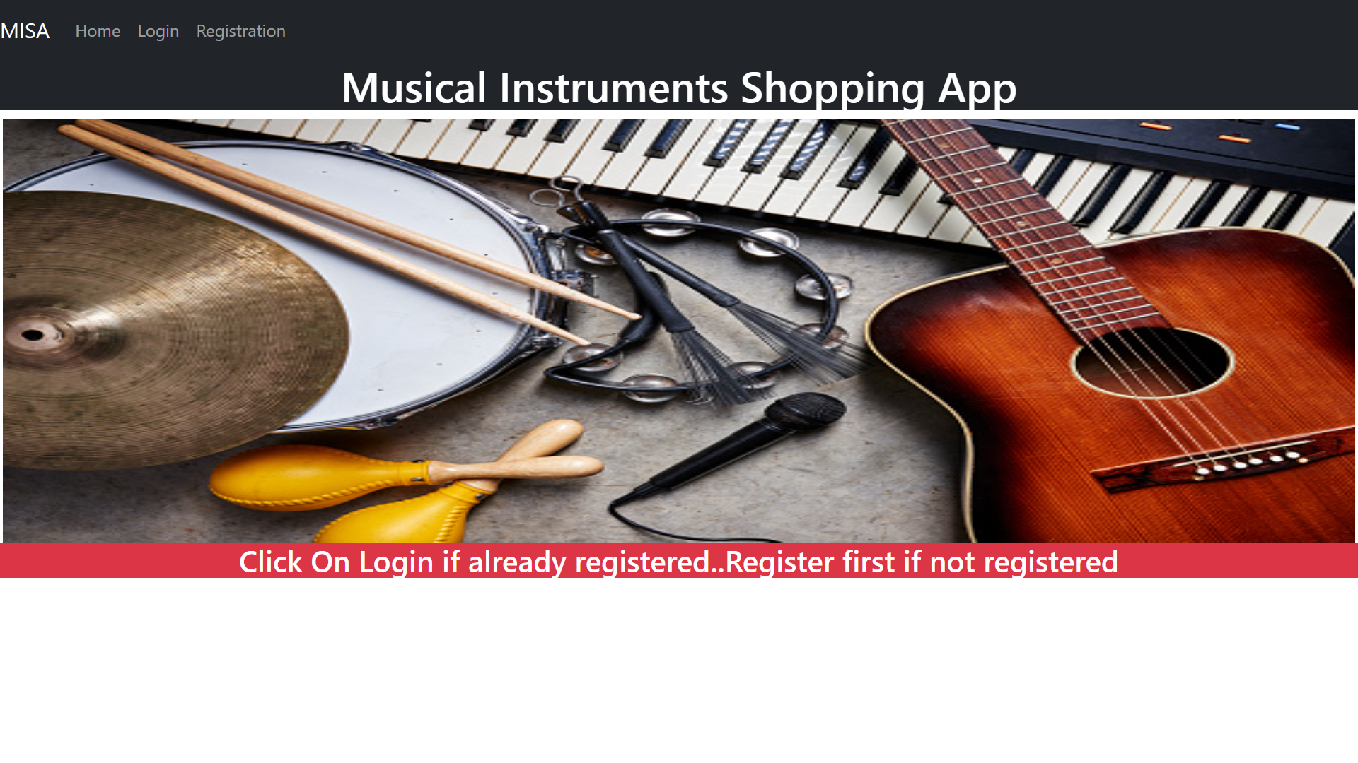
ScreenShots of Project :

Slide 13
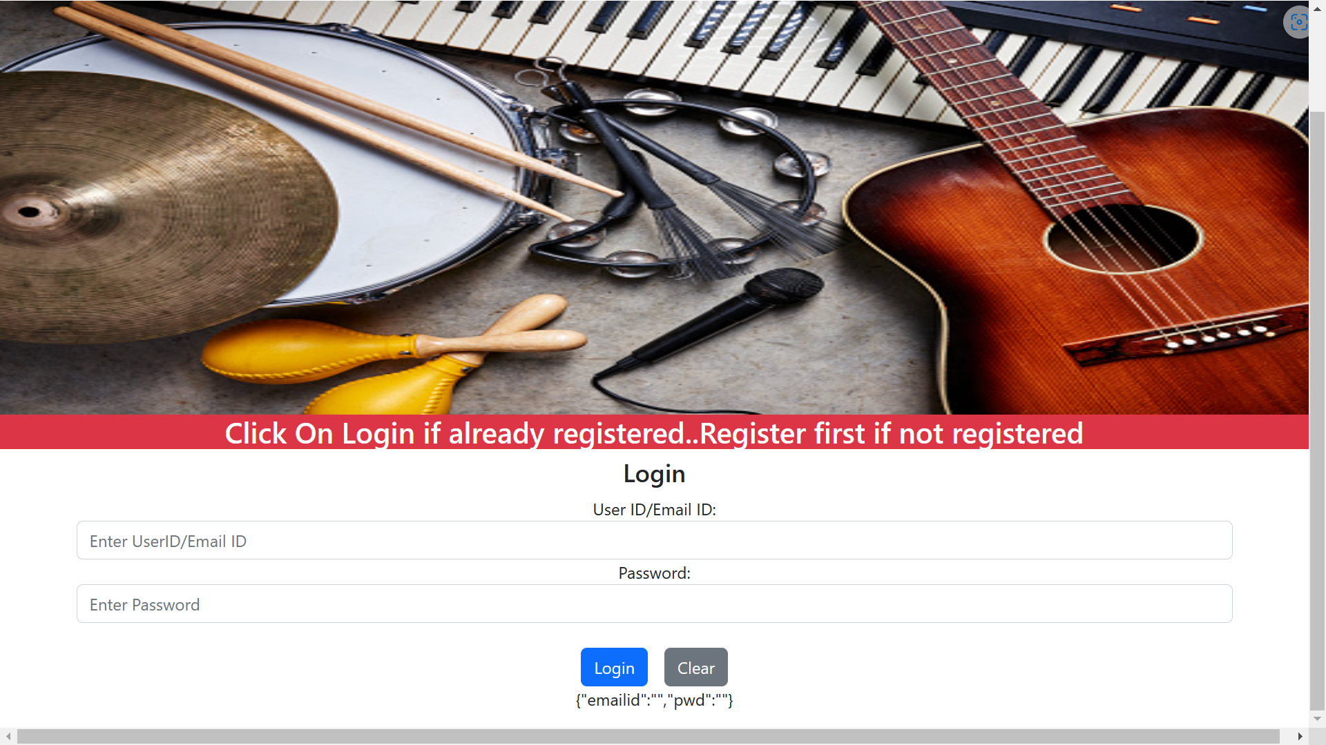
Login:

Slide 14
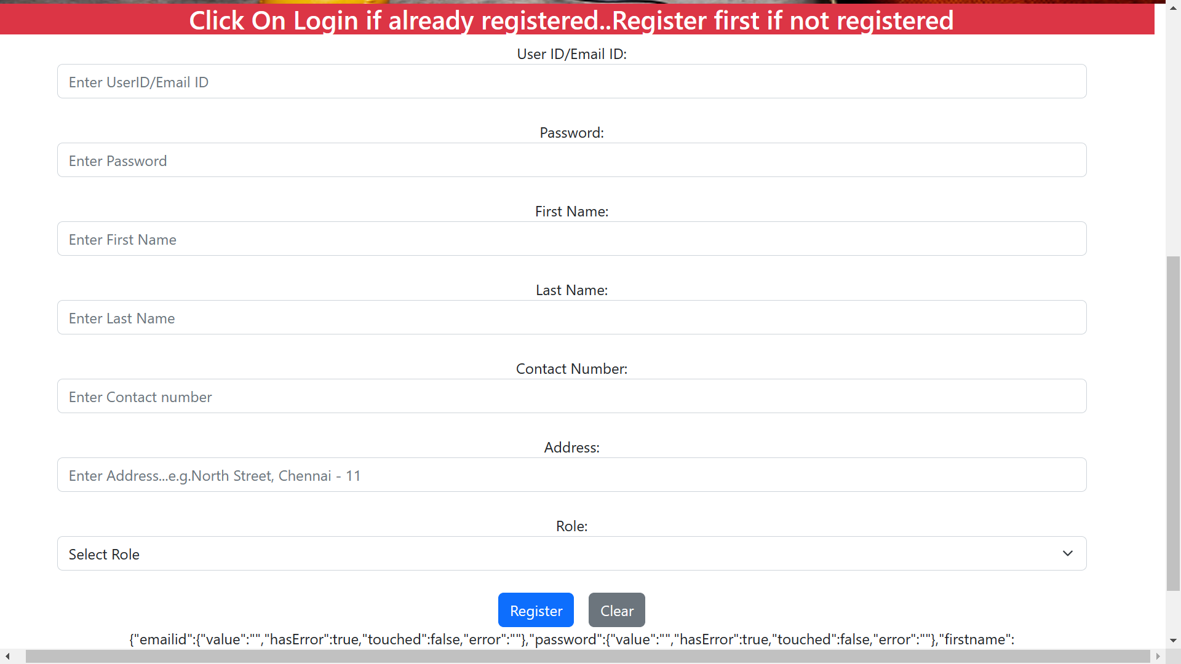
Registration Page for buyer/seller:

Slide 15
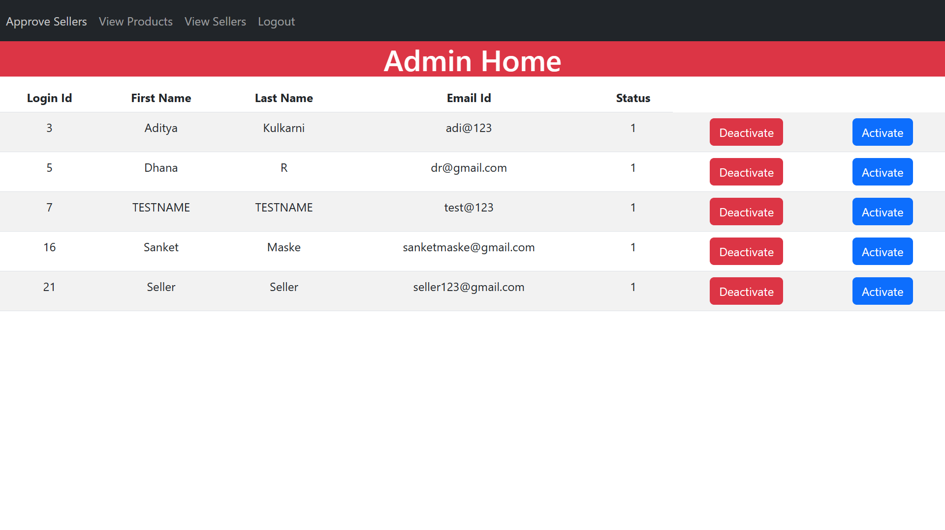
Seller Approval:

Slide 16
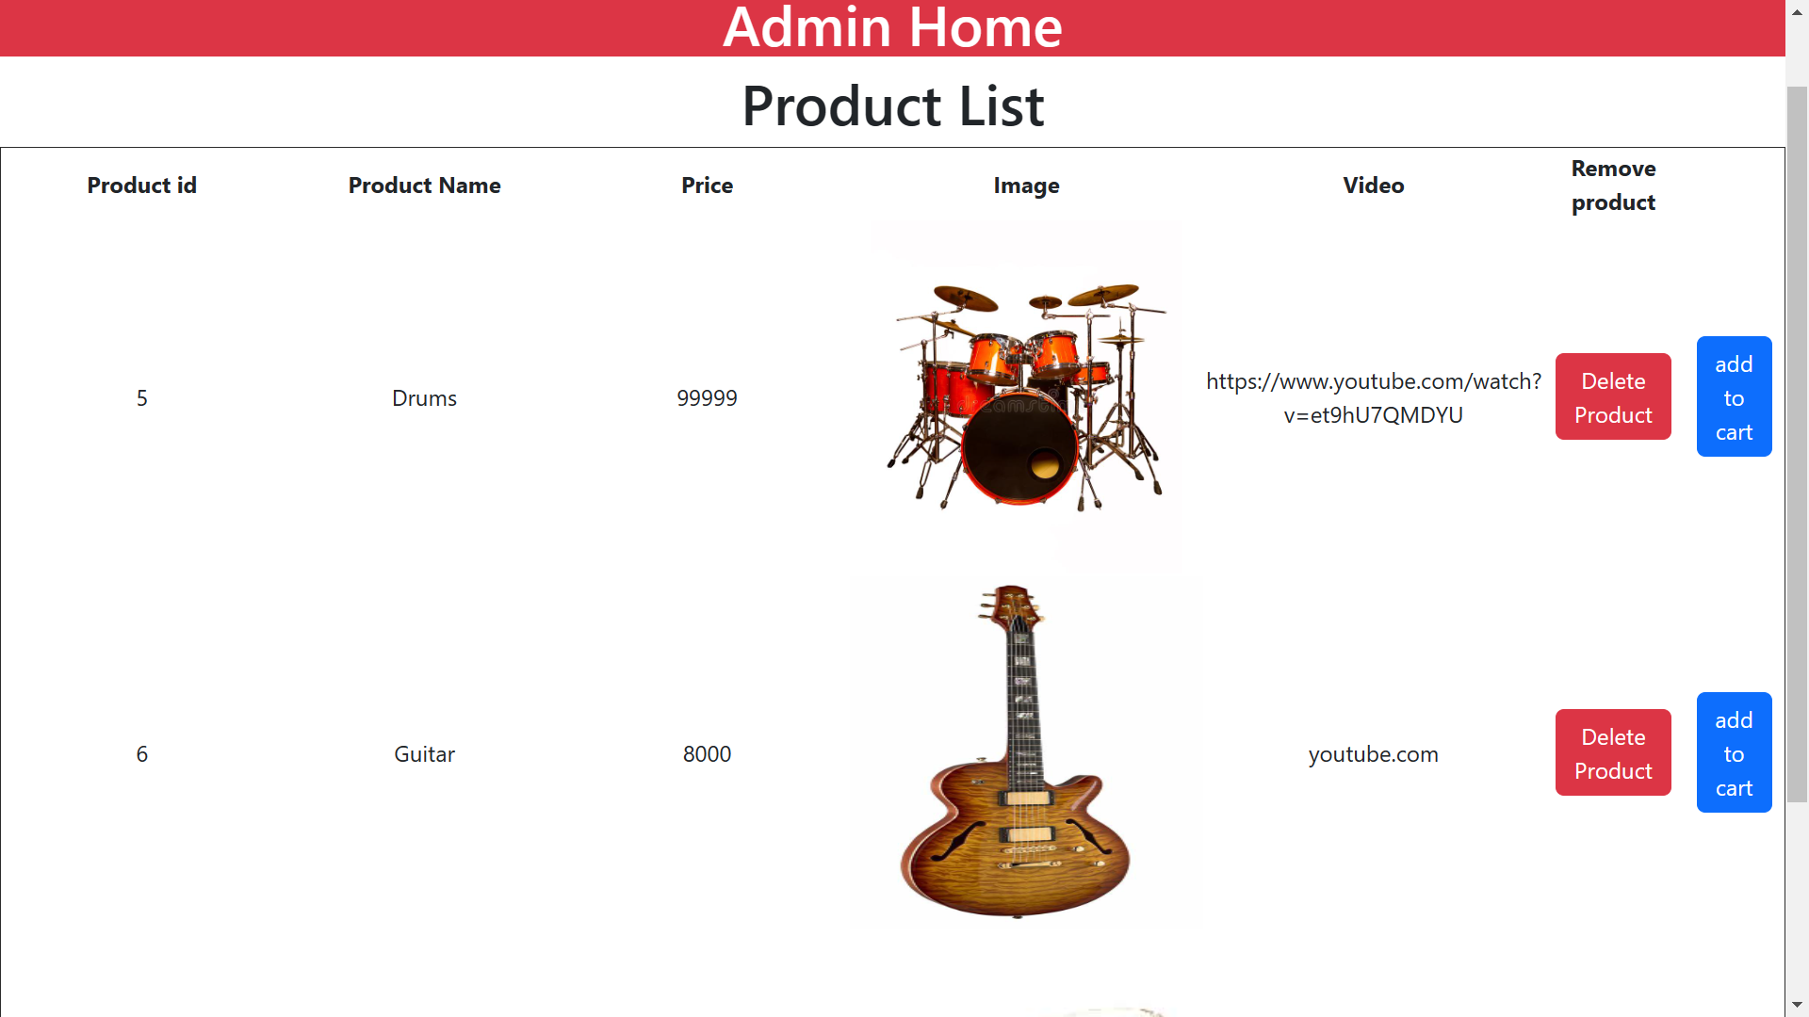
Product list:

Slide 17
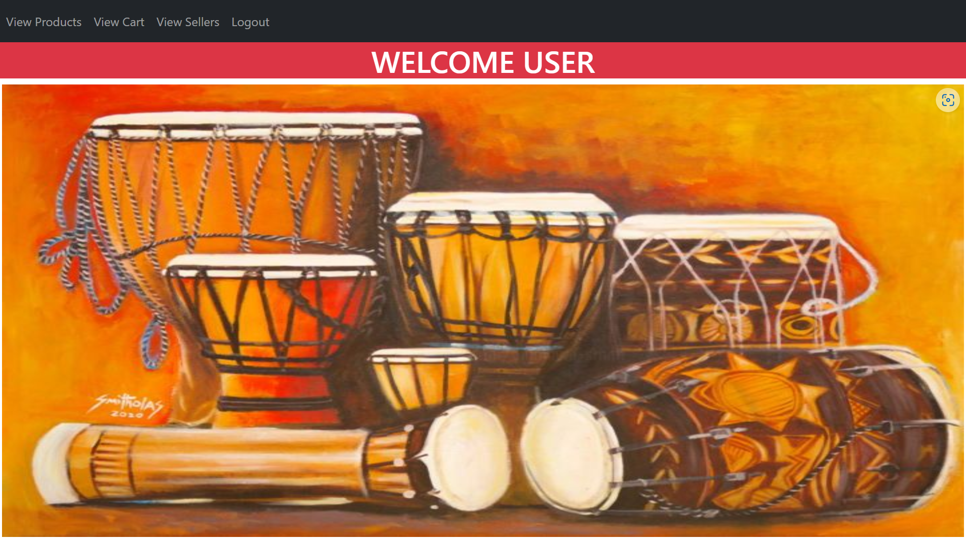
User’s Page:

Slide 18
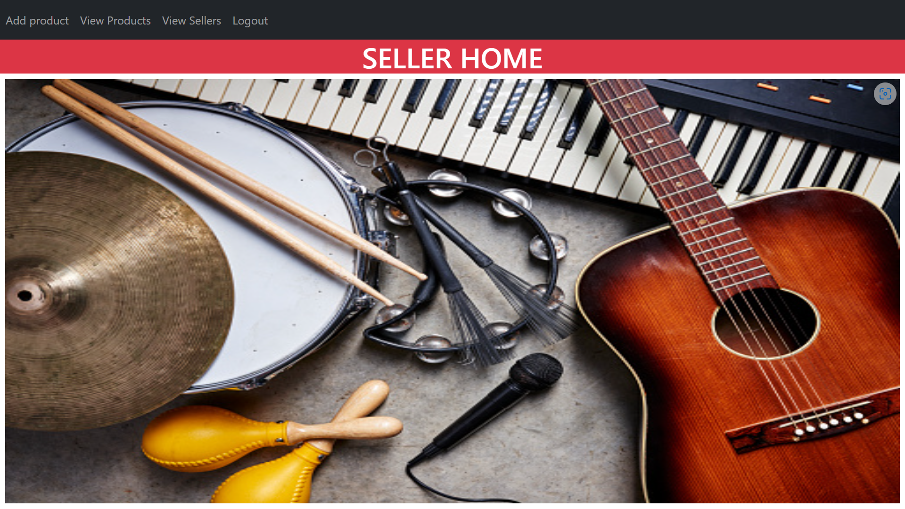
Sellers home:

Slide 19
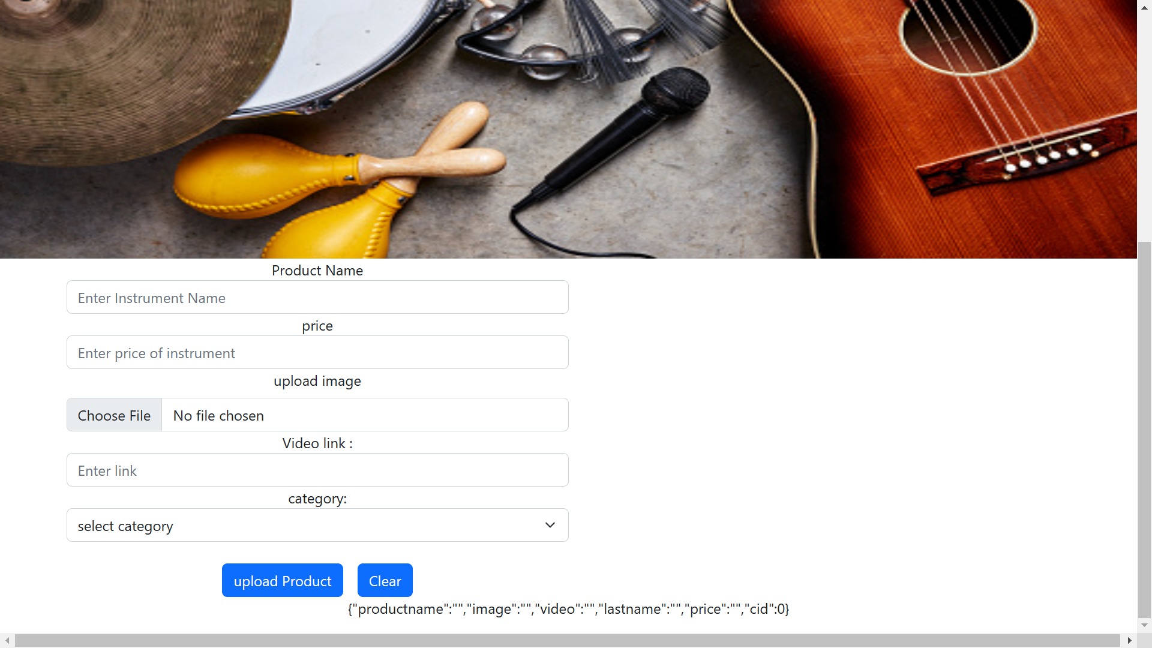
Seller can Upload Product information:

Slide 20
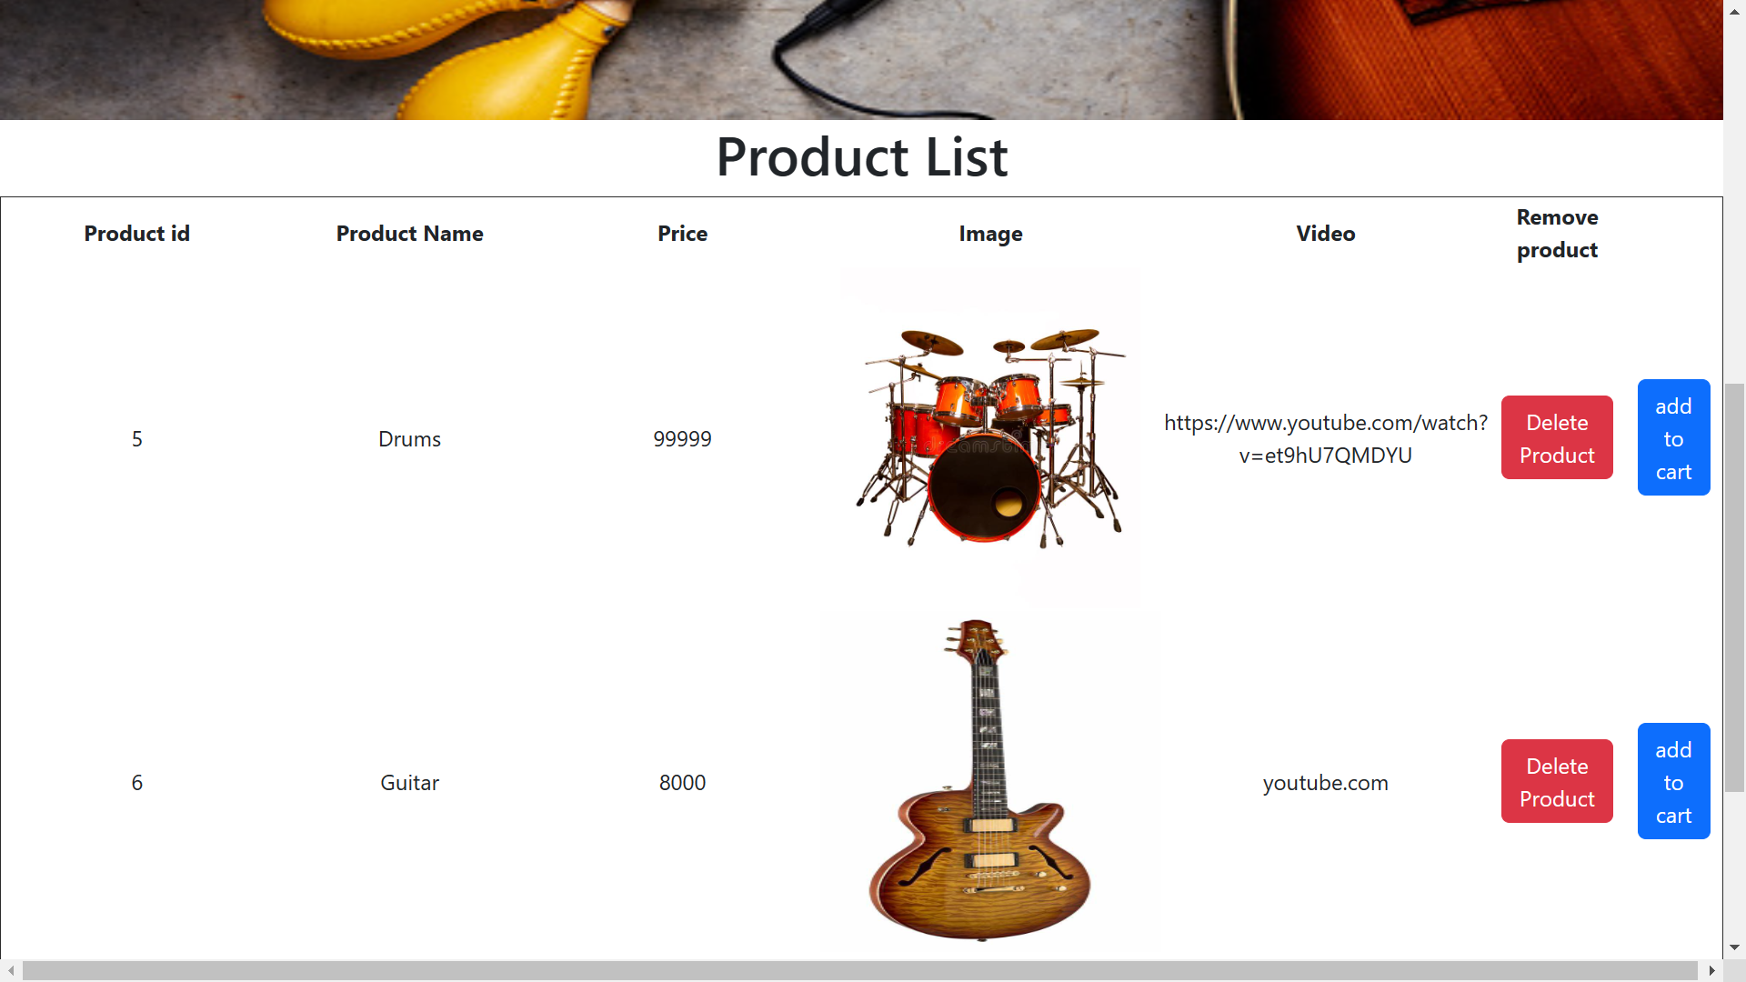
Product list to add to cart:

Slide 21
Conclusion and scope:
Online instrument shopping app has more opportunities to compare prices
of instrument than traditional shopping.
This app gives helps to grow the business, and transforms the way people
shop for musical instruments online.
This app help to seller to enhance the business .
Our designed online shopping system provides a 24×7 service

Slide 22
Thank you

